Slide 1
Near Earth
Objects
By:
Syed Haider Ali
Daniyal Nazeer
Ammarah Bria
Hafsa Bibi
M. Abdullah Javaid

Slide 2
Layout
Introduction
Importance of Statistical Analysis
Extract Transform Load (ETL)
Exploratory Data Analysis (EDA)
Statistical Decision Making
Conclusion

Slide 3
Introduction
“NEO” stands for “near-Earth object”
Perihelion distance less than 1.3 AU
Our analysis is of only the asteroid component of that population, called near-Earth asteroids (NEAs)
Class types under “Amors”, “Apollos”, “Atens” and “interior-to-earth”

Slide 4
Importance of Statistical Analysis
Answering Real world questions in a Data-Driven manner
Empirical evidence of theories in scientific experiments.
Comparing theoretical models with experimental to a significance level

Slide 5
Overview
Any Statistical Study is broken down into multiple steps
Extract, Transform, Load (ETL)
Exploratory Data Analysis (EDA)
Statistical Decision Making

Slide 6
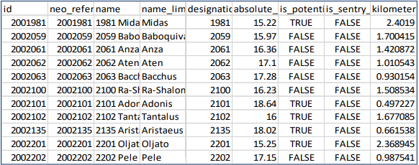
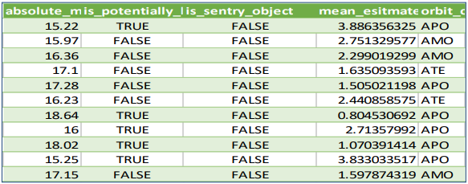
Extract, Transform, Load (ETL)
Cleaning Dirty Data
Transformation of unorganized raw data into a structured form
Use of Excel's power query
Removal of:
Null values
Unnecessary columns
Duplicates
Exploratory Data Analysis (EDA)
Statistical Decision Making

Slide 7
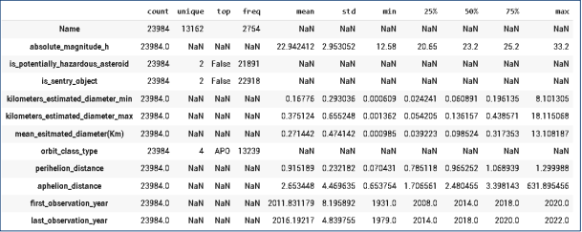
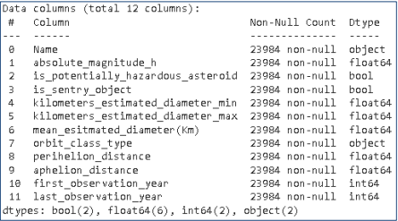
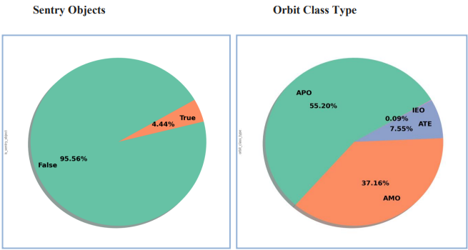
Exploratory Data Analysis (EDA)
Asking the Right Questions
Initial investigations on data to discover patterns, to spot anomalies, to test hypothesis and to check assumptions with the help of summary statistics and graphical representations.
Statistical Decision Making

Slide 8
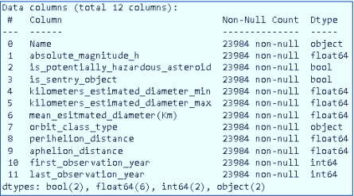
Statistical Decision Making

Slide 9
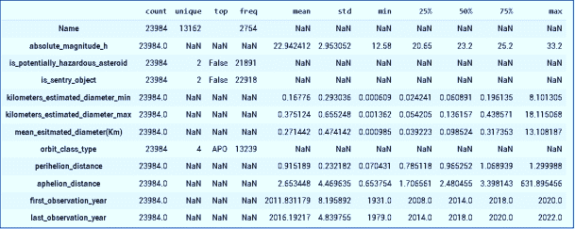
Statistical Decision Making

Slide 10
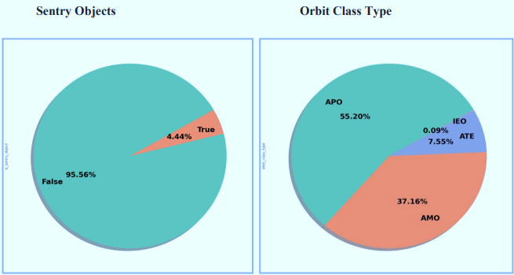
Statistical Decision Making

Slide 11
Statistical Decision Making
Upon performing the EDA, inferences are likely to be drawn from the data
Orbital characteristics & asteroid hazardous potential
Asteroid orbit class type and their distance comparison
Asteroid types and time series analysis

Slide 12
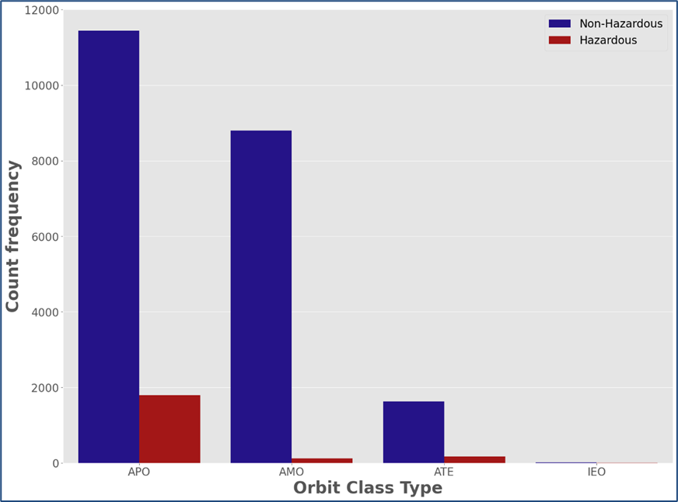
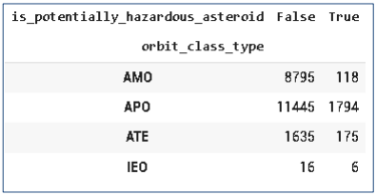
Orbital characteristics & asteroid hazardous potential
Asteroid orbit class type and their distance comparison
Asteroid types and time series analysis

Slide 13
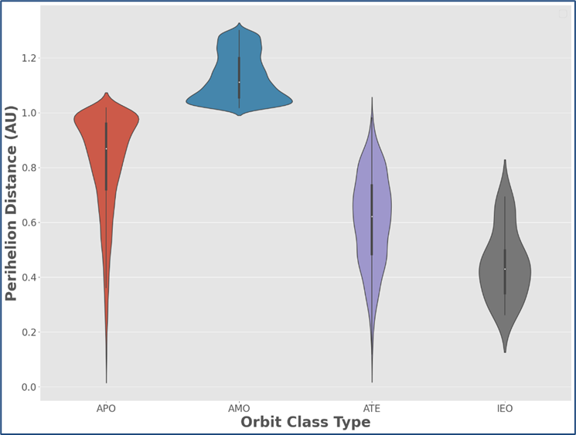
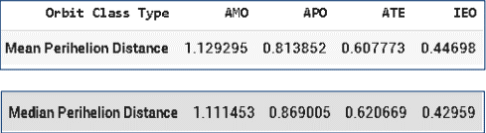
Asteroid orbit class type and their distance comparison
Orbital characteristics & asteroid hazardous potential
Asteroid types and time series analysis

Slide 14
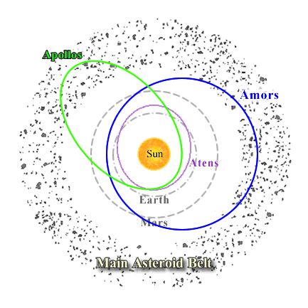
Asteroid types and time series analysis

Slide 15
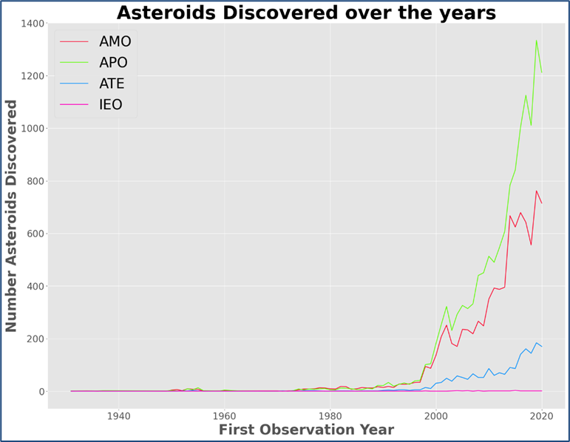
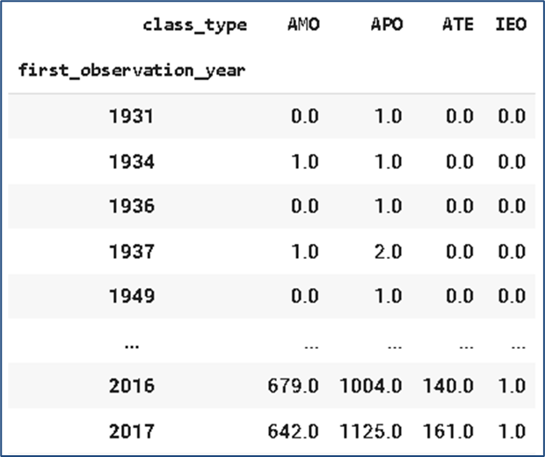
Asteroid types and time series analysis
Orbital characteristics & asteroid hazardous potential
Asteroid orbit class type and their distance comparison

Slide 16
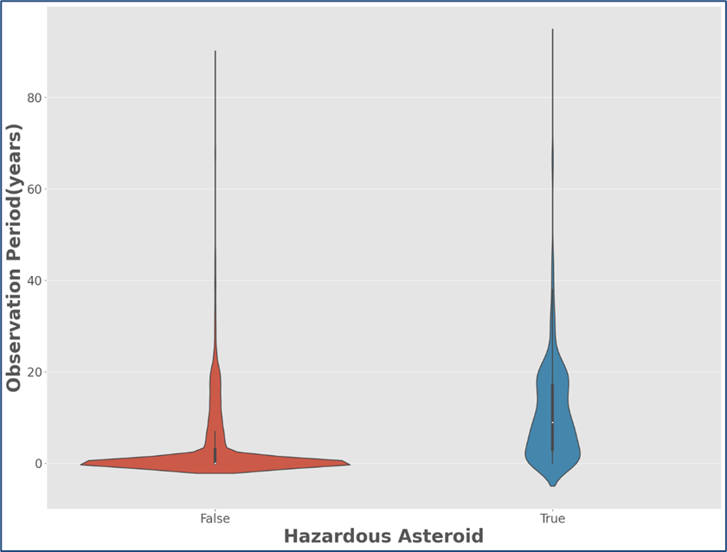
Hazard Potential and Observation Period
Orbital characteristics & asteroid hazardous potential
Asteroid orbit class type and their distance comparison

Slide 17
Conclusion
Upon the Data-Driven inspection we can conclude:
Apollo Type asteroids are generally the most hazardous and numerous type.
Amor Type asteroids have the most perihelion distance
Asteroids with higher observation period to be more hazardous.

Slide 18
Thank you

